Slide 1
AWS Analytics Service
10 Mar, 2025

Slide 2
Course : Amazon Redshift
Lecture On : AWS Analytics Service
Instructor : Nitin

Slide 3
In Last Class, we covered….
01
DML Commands
02
Analysing and Vacuuming Tables
03
Automating CTAS Table Analysis
04
Create UDFs

Slide 4
Poll 1(Answer)
Which of these are categorical variables?
Temperature of an engine
Make of car
Mileage of a car
Rating given by a customer for an Uber ride
Practice in teams of 4 students
Industry expert mentoring to learn better
Get personalised feedback for improvements

Slide 5
Today’s Agenda
01
Overview of analytics
Identifying challenges with analytics
AWS services for challenges with analytics
Introduction to Data Lakes
Introduction to Data Warehousing
AWS Services for Modern Data Architecture
02
03
04
05
06

Slide 6
Overview of Analytics
Analytics
The process of using specialized tools and techniques to find new value from raw data
Data analysis
The practice of interpreting data that leads to meaningful decisions.

Slide 7
Analytics benefits
Analytics is vital to every organization.
Analytics helps companies decide where and when to launch new products, when to offer discounts, and when to market in new areas.
Without the information provided by analytics, many decision-makers would base their decisions on intuition and pure luck.

Slide 8
Analytics types and techniques
Descriptive analytics
It helps to answer what happened.
It uses data visualization techniques, such as:
Pie charts
Bar charts
Line graphs
Tables

Slide 9
Analytics types and techniques
Diagnostic analytics
It helps to answer why it happened.
It uses techniques, such as:
Drill down
Data Discovery
Data Mining
Correlations

Slide 10
Analytics types and techniques
Predictive analytics
It helps to answer what might happen in the future.
It uses techniques, such as:
Machine Learning (ML)
Forecasting
Pattern Matching
Predictive Modelling

Slide 11
Analytics types and techniques
Prescriptive analytics
It helps to recommends actions to the predicted outcome.
It uses techniques, such as:
Graph Analysis
Simulation
Complex event processing
Neural networks
Recommendation engine

Slide 12
5 Vs of Big Data
Big Data
Data that is stored rapidly from various sources, massive in size, and is complicated for organizations to secure, analyze, and gain valuable insight from.

Slide 13
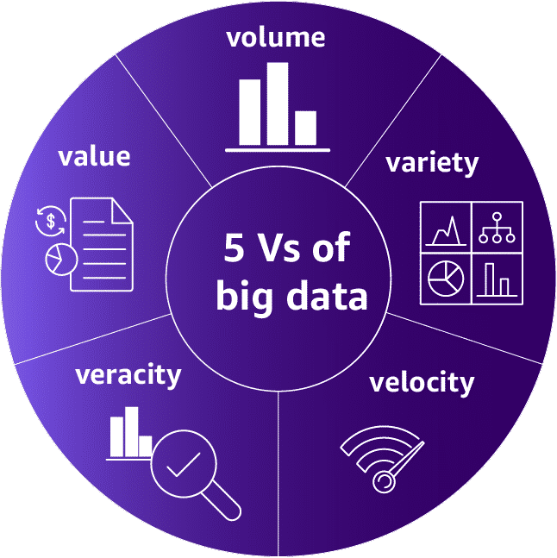
Big data challenges
Credit: Amazon Web Services

Slide 14
Big data challenges
The amount of data that will be ingested by the solution
Credit: Amazon Web Services

Slide 15
Big data challenges
The number of different sources and the type of sources that the solution will use.
Credit: Amazon Web Services

Slide 16
Big data challenges
The speed of data entering and flowing through to be processed. The requirement is near real time data ingestion & processing.
Credit: Amazon Web Services

Slide 17
Big data challenges
The degree to which data is accurate, precise, and trusted.
Credit: Amazon Web Services

Slide 18
Big data challenges
The ability to extract meaningful information from the data.
Credit: Amazon Web Services

Slide 19
AWS solutions - Volume
Amazon S3
Store any amounts of object storage with scalability, availability, and security.
AWS Lake Formation
Build, manage, and secure data lakes faster and more conveniently.
Amazon Redshift
Use cloud data warehousing with the best price performance.

Slide 20
AWS solutions - Variety
Amazon RDS : Cloud-based relational database for convenient setup, operation, and scaling
Amazon DynamoDB : Fast, flexible, fully managed NoSQL database for high performance at any scale
Amazon OpenSearch Service : Real-time search, monitoring, and analysis of business and operational data
Amazon Redshift : Best price-performance for cloud data warehousing

Slide 21
AWS solutions - Velocity
Amazon EMR
Big data solution for petabyte-scale data processing, interactive analytics, and ML
Amazon MSK
Fully managed, highly available Apache Kafka service
Amazon Kinesis
Cost-effective service to processes and analyze streaming data at any scale as a fully managed service
AWS Lambda
Serverless, event-driven compute service that lets you run code without provisioning or managing servers

Slide 22
AWS solutions - Veracity
Amazon EMR : Streamline collection and processing data for big data workloads.
Amazon Glue : Prepare and integrate all your data at any scale.
AWS Glue DataBrew : Clean and normalize data faster and more efficiently.
Amazon DataZone : Share data across your organization with built-in governance.

Slide 23




AWS solutions - Value
Amazon QuickSight
Unified business intelligence at cloud-scale.
Amazon SageMaker
Build, train, and deploy ML models with fully managed infrastructure, tools, and workflows.
Amazon Bedrock
Build and scale generative AI applications with foundation models.
Amazon Athena
Analyze petabyte-scale data where it lives.

Slide 24
What is a data lake?
It is a centralized repository that an organization can use to store data at scale, both structured and unstructured, in its original format.
Data lakes ingest raw data from various sources such as databases, sensors, social media, documents, and applications.
Prior to analysis, the raw data might undergo transformations such as cleansing, normalization, aggregation, and more.

Slide 25
Benefits of data lakes
Scalability
Cost-efficiency
Flexibility
Centralized View
Faster Analysis

Slide 26
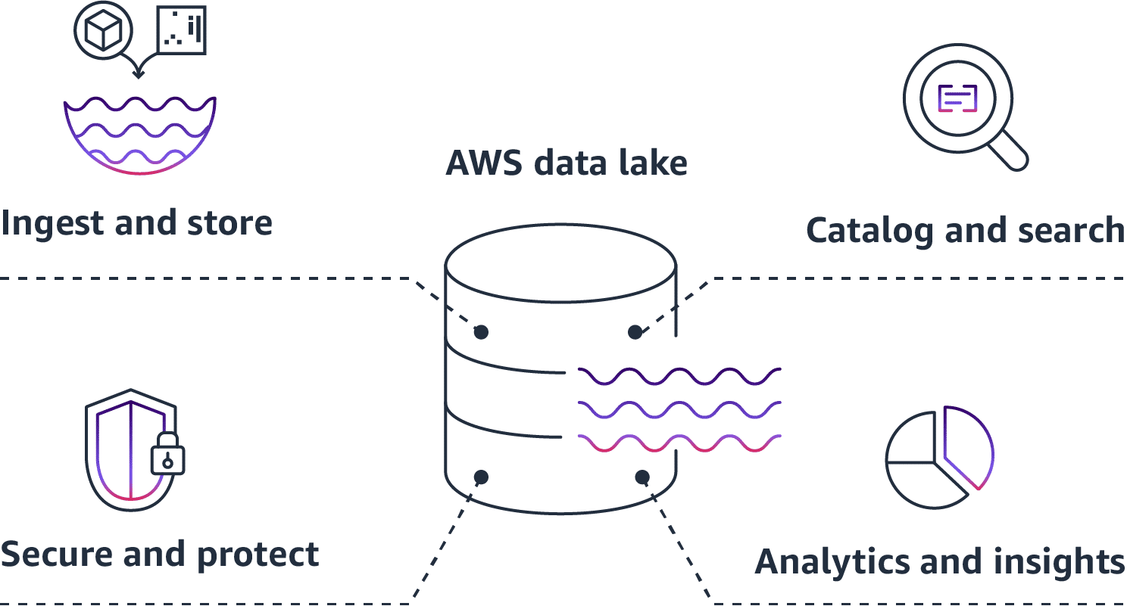
Data lake functions
Credit: Amazon Web Services

Slide 27
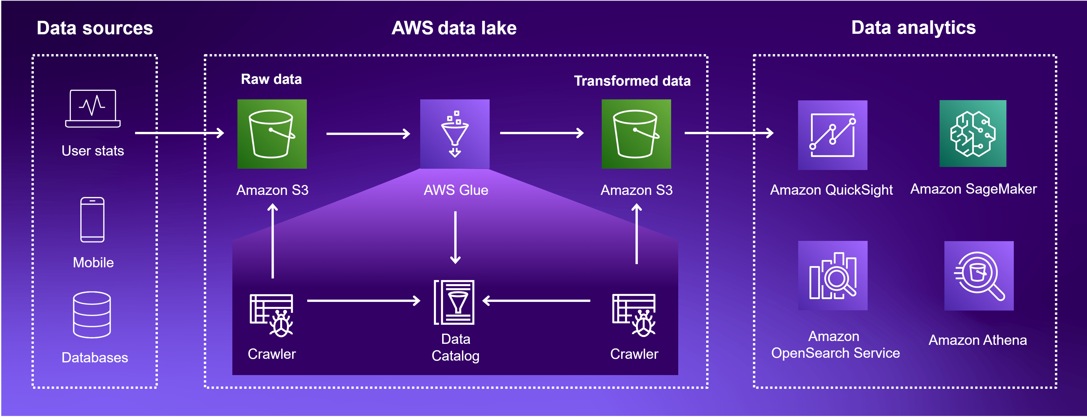
Basic data lake architecture
Credit: Amazon Web Services

Slide 28
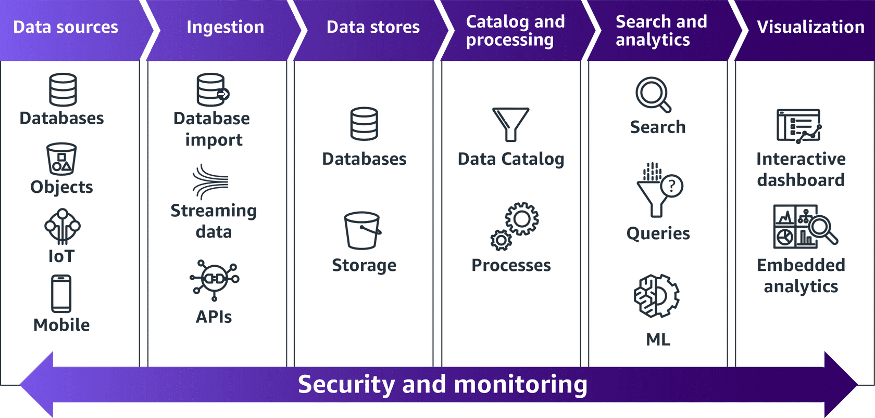
AWS Analytics Pipeline
Credit: Amazon Web Services

Slide 29
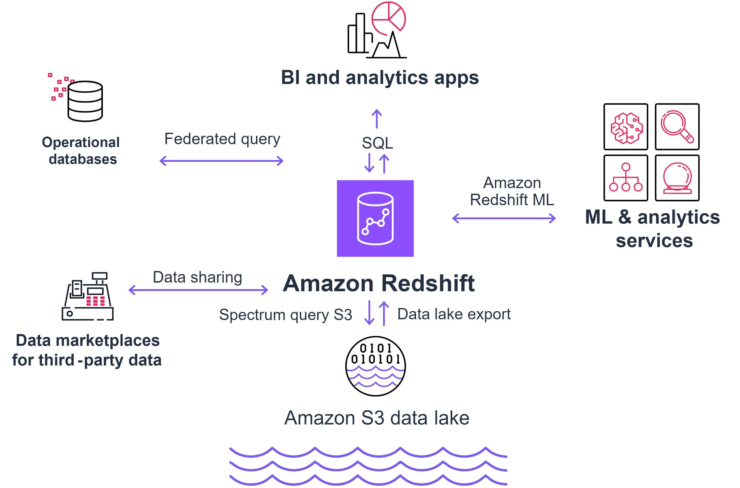
Zero-ETL
Credit: Amazon Web Services

Slide 30
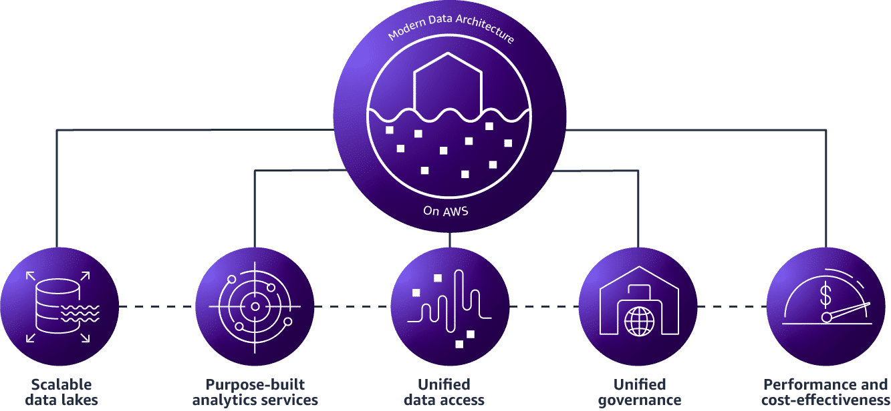
Pillars of a modern data architecture
Credit: Amazon Web Services

Slide 31

AWS services for scalable data lakes
Amazon S3
AWS Lake Formation
AWS Glue Data Catalog
Credit: Amazon Web Services

Slide 32

AWS services for purpose-built analytics
Amazon RDS
Amazon DynamoDB
Amazon Athena
Amazon QuickSight
Amazon SageMaker
Amazon EMR
Amazon Redshift
Amazon Managed Service for Apache Flink
Credit: Amazon Web Services

Slide 33

AWS services for unified data access
AWS Glue
Amazon Kinesis Data Firehose
Credit: Amazon Web Services

Slide 34

AWS services for unified governance
AWS DataZone
Amazon Lake Formation
Credit: Amazon Web Services

Slide 35
Knowledge Check
Which AWS service is primarily used for real-time streaming data analytics?
Amazon Redshift
Amazon S3
Amazon Kinesis
AWS Glue
35

Slide 36
Knowledge Check
Which AWS service is primarily used for real-time streaming data analytics?
Amazon Redshift
Amazon S3
Amazon Kinesis
AWS Glue
36

Slide 37
Knowledge Check
In AWS, which service can be used to transform and prepare data for analytics, providing a serverless ETL (Extract, Transform, Load) solution?
Amazon RDS
AWS Glue
Amazon Athena
Amazon QuickSight
37

Slide 38
Knowledge Check
In AWS, which service can be used to transform and prepare data for analytics, providing a serverless ETL (Extract, Transform, Load) solution?
Amazon RDS
AWS Glue
Amazon Athena
Amazon QuickSight
38

Slide 39
Knowledge Check
Which AWS service is best suited for running SQL queries directly on data stored in Amazon S3 without needing to load the data into a database?
Amazon Athena
Amazon Redshift
Amazon EMR
AWS Glue
39

Slide 40
Knowledge Check
Which AWS service is best suited for running SQL queries directly on data stored in Amazon S3 without needing to load the data into a database?
Amazon Athena
Amazon Redshift
Amazon EMR
AWS Glue
40

Slide 41
Knowledge Check
Which AWS service helps you visualize data and create interactive dashboards with ease for business intelligence purposes?
Amazon QuickSight
Amazon S3
AWS Glue
Amazon ElasticSearch
41

Slide 42
Knowledge Check
Which AWS service helps you visualize data and create interactive dashboards with ease for business intelligence purposes?
Amazon QuickSight
Amazon S3
AWS Glue
Amazon ElasticSearch
42

Slide 43
KEY TAKEAWAY
Data Analytics involves examining and interpreting data to uncover patterns, trends, and insights that inform decision-making.
It leverages statistical methods, algorithms, and tools to extract actionable knowledge from raw data.
01
43

Slide 44
NEXT CLASS
01
Introduction to Amazon Redshift security and compliance
02
Authentication with Amazon Redshift
03
Access control with Amazon Redshift
04
Data encryption with Amazon Redshift
05
Disaster recovery
06
Backing up and restoring Amazon Redshift provisioned
44

